Slide 1
Problem description and pipeline

Slide 2
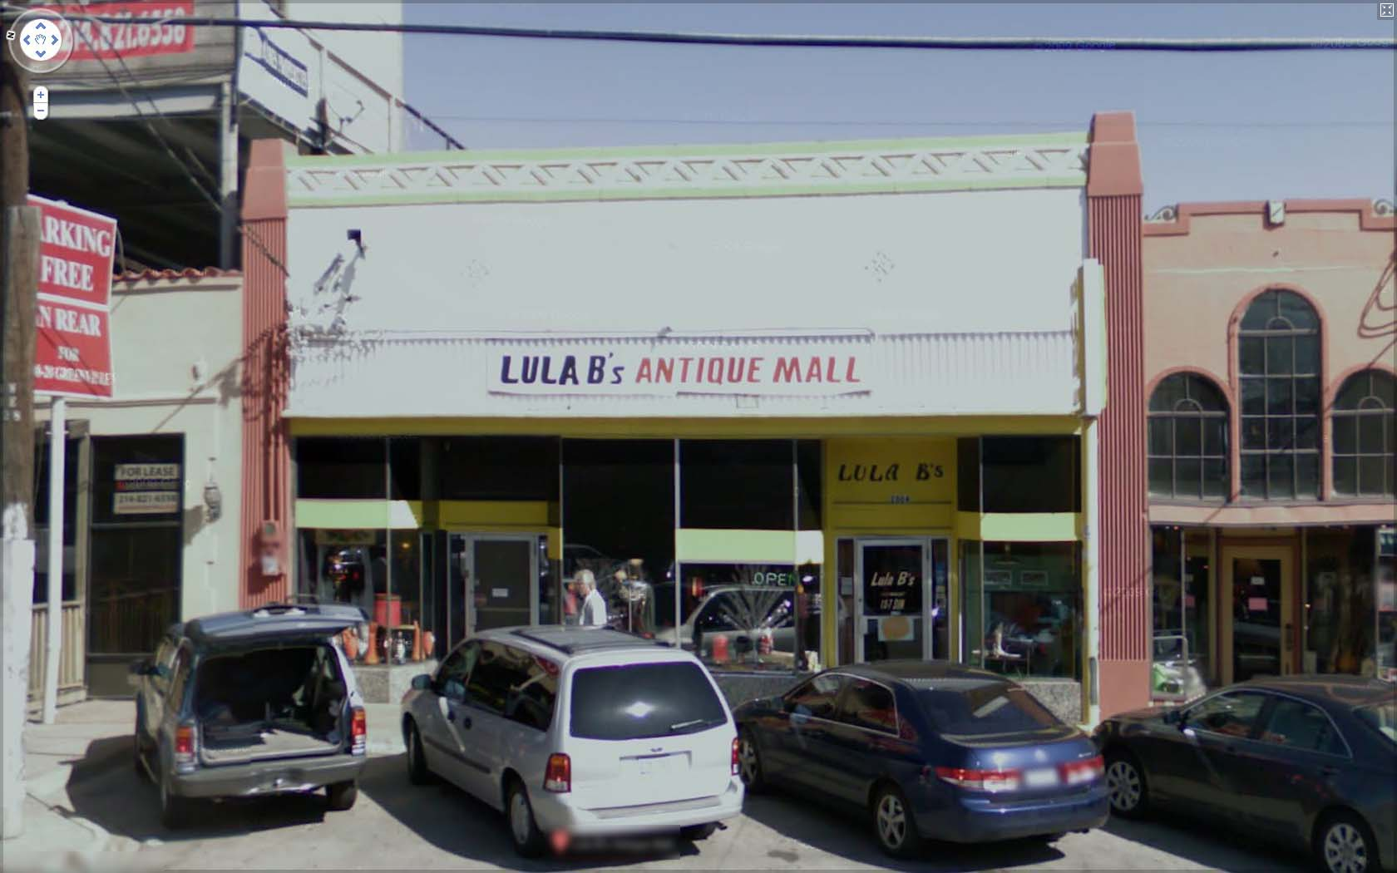
The Photo OCR problem
LULA B’s ANTIQUE MALL
LULA B’s
OPEN
LULA B’s

Slide 3
Photo OCR pipeline
1. Text detection
2. Character segmentation
3. Character classification
A
N
T

Slide 4
Photo OCR pipeline
Image
Text detection
Character segmentation
Character recognition
Engineers

Slide 5
Sliding Window

Slide 6
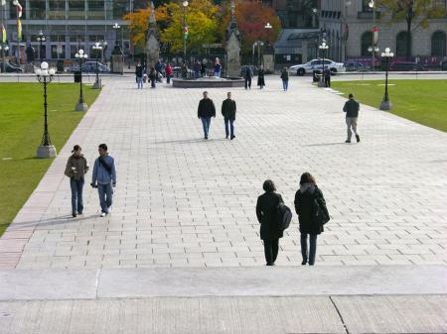
Text detection
Pedestrian detection
Aspect ratio of rectangles is different
Aspect ratio of rectangles is same

Slide 7
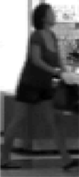
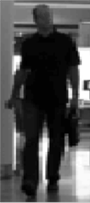
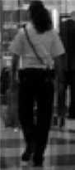
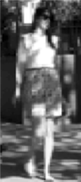
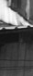
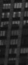


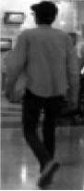
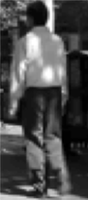
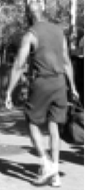
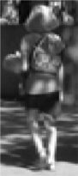
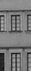
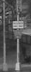

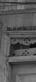
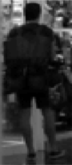
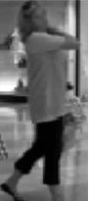
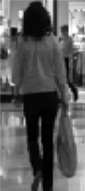
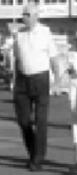




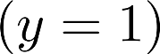
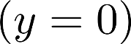
Supervised learning for pedestrian detection
pixels in 82x36 image patches
Positive examples
Negative examples

Slide 8
Sliding window detection

Slide 9
Sliding window detection

Slide 10
Sliding window detection

Slide 11
Text detection

Slide 12
Text detection
Positive examples
Negative examples

Slide 13
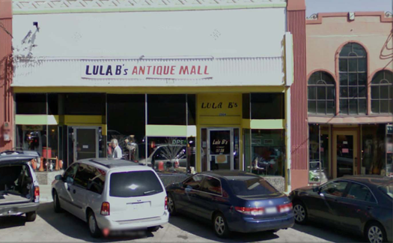


We can discard boxes who's height and width are
almost same as text should have more width
as compared to the height. But it might lead to
Skipping some text.
Text detection
[David Wu]
Notes:
Expansion
Rectangles around operator

Slide 14
1D Sliding window for character segmentation
Positive examples
Negative examples
Notes:
Change it to segmentation examples instead:

Slide 15
Photo OCR pipeline
1. Text detection
2. Character segmentation
3. Character classification
A
N
T

Slide 16
Getting Lots of Data and Artificial Data

Slide 17
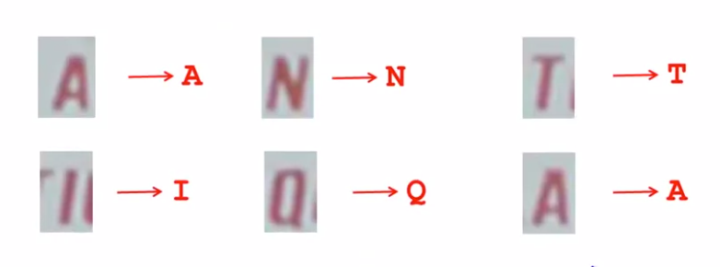
Character Recognition

Slide 18
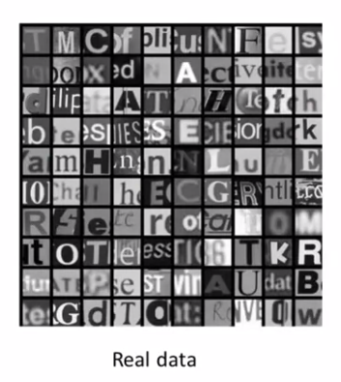
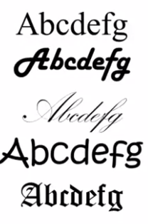
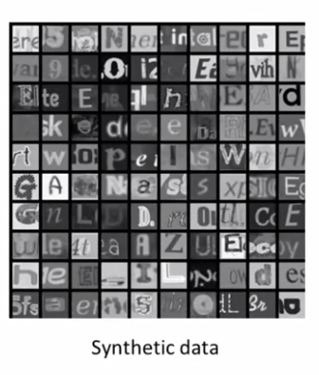
Artificial data synthesis for OCR
Computer Fonts

Slide 19
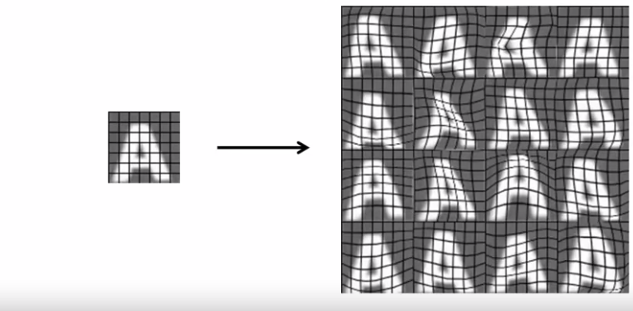
Synthesizing data by introducing distortions

Slide 20
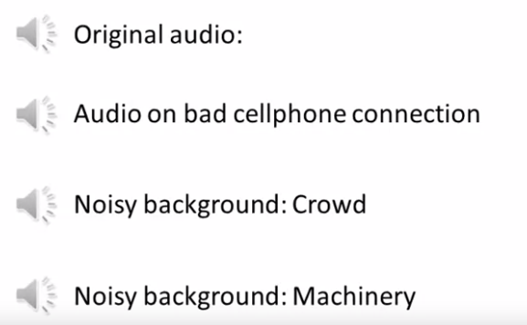
Synthesizing data by introducing distortions

Slide 21
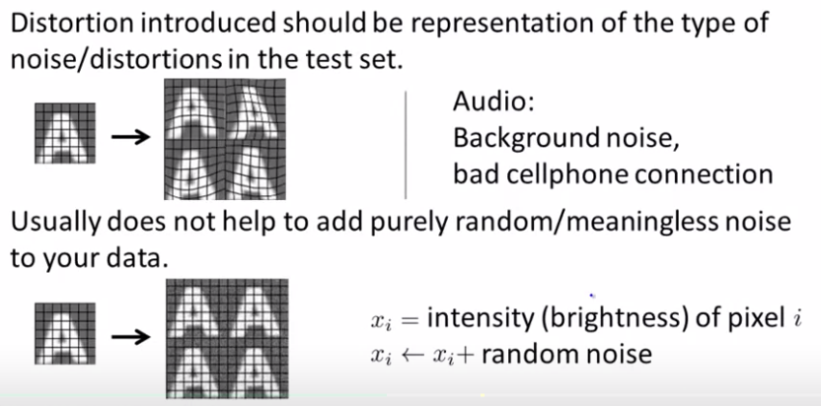
Synthesizing data by introducing distortions

Slide 22
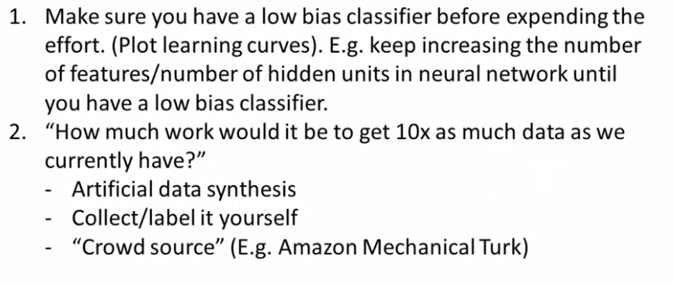
Discussion on getting more data

Slide 23
Analysis: What part of Pipelines to work on next:

Slide 24
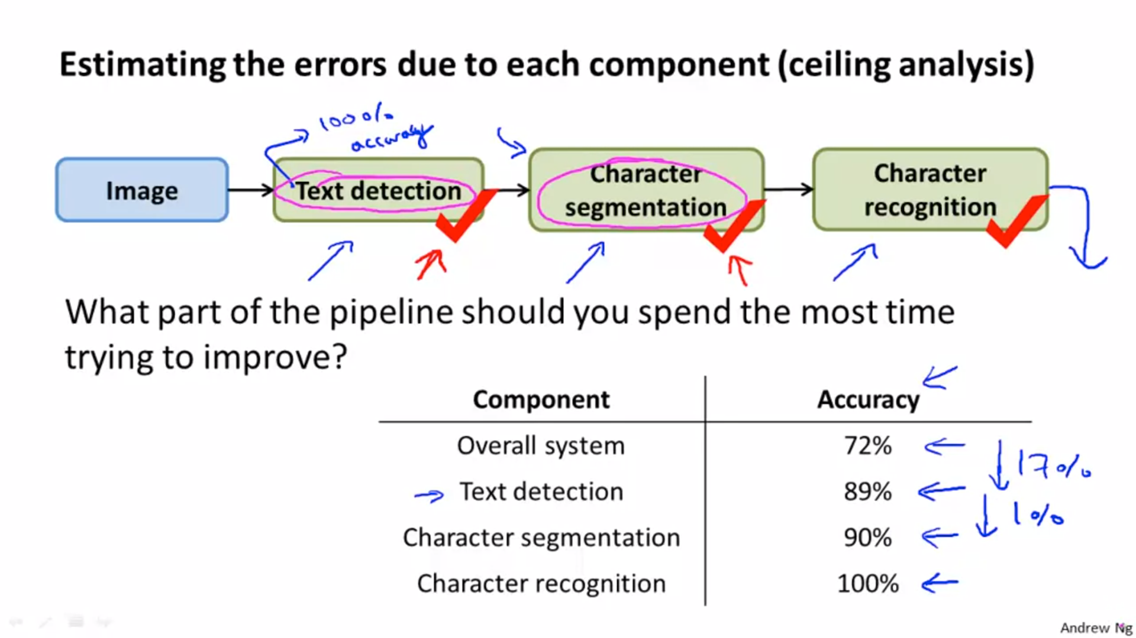

Slide 25
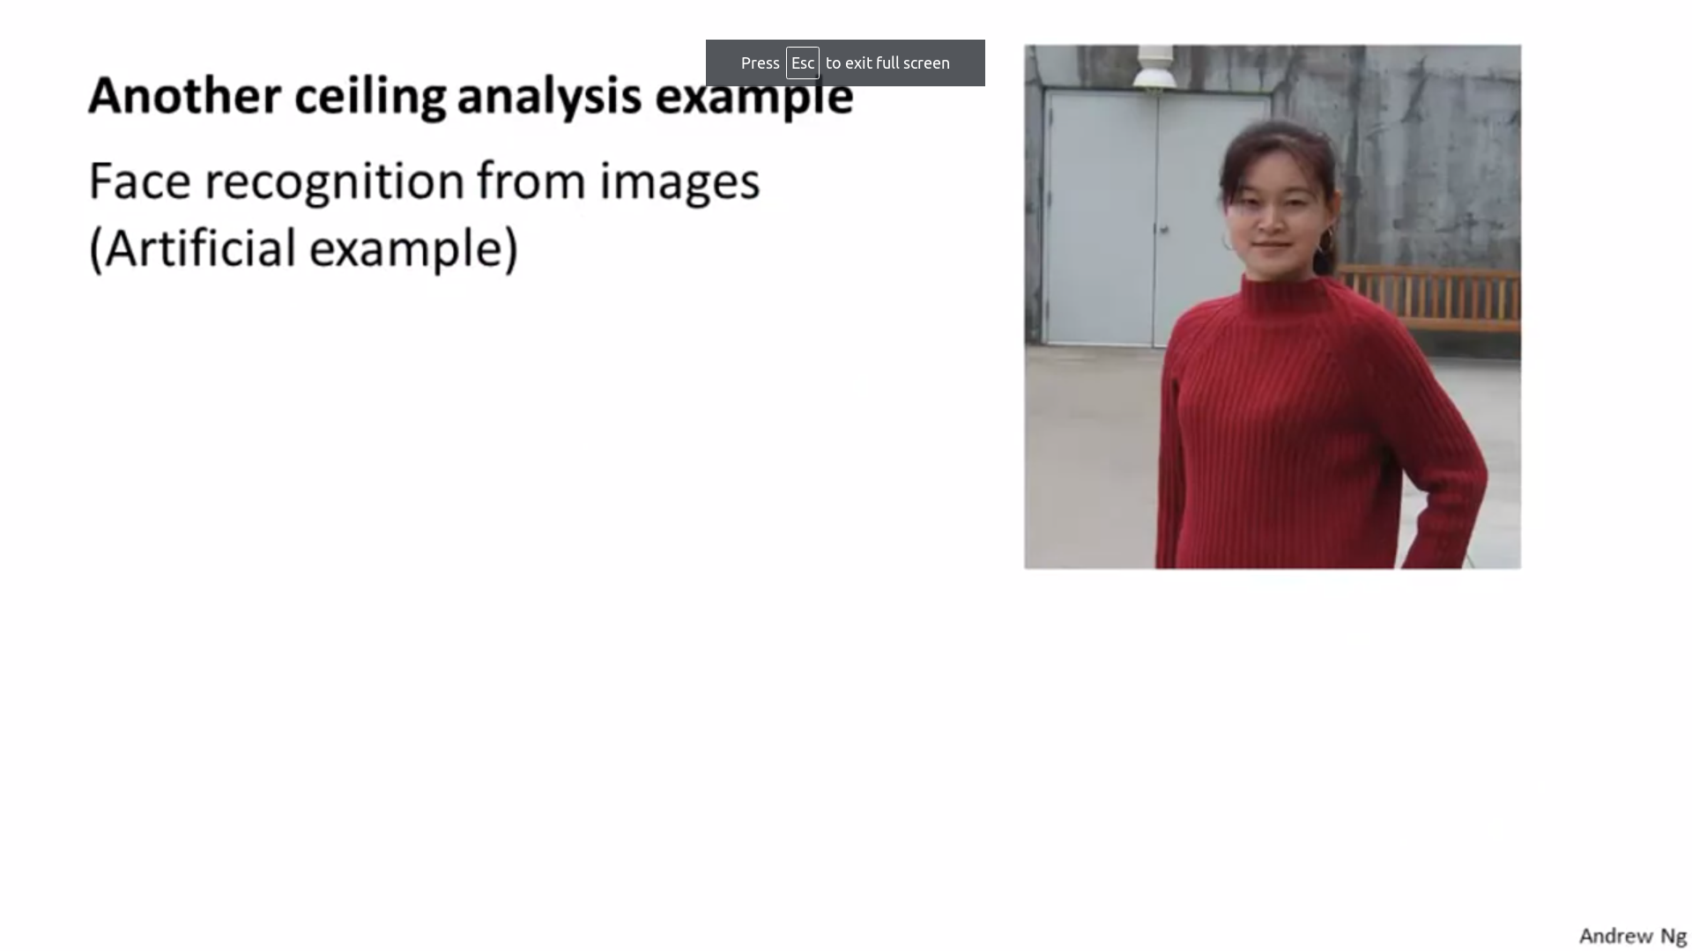

Slide 26
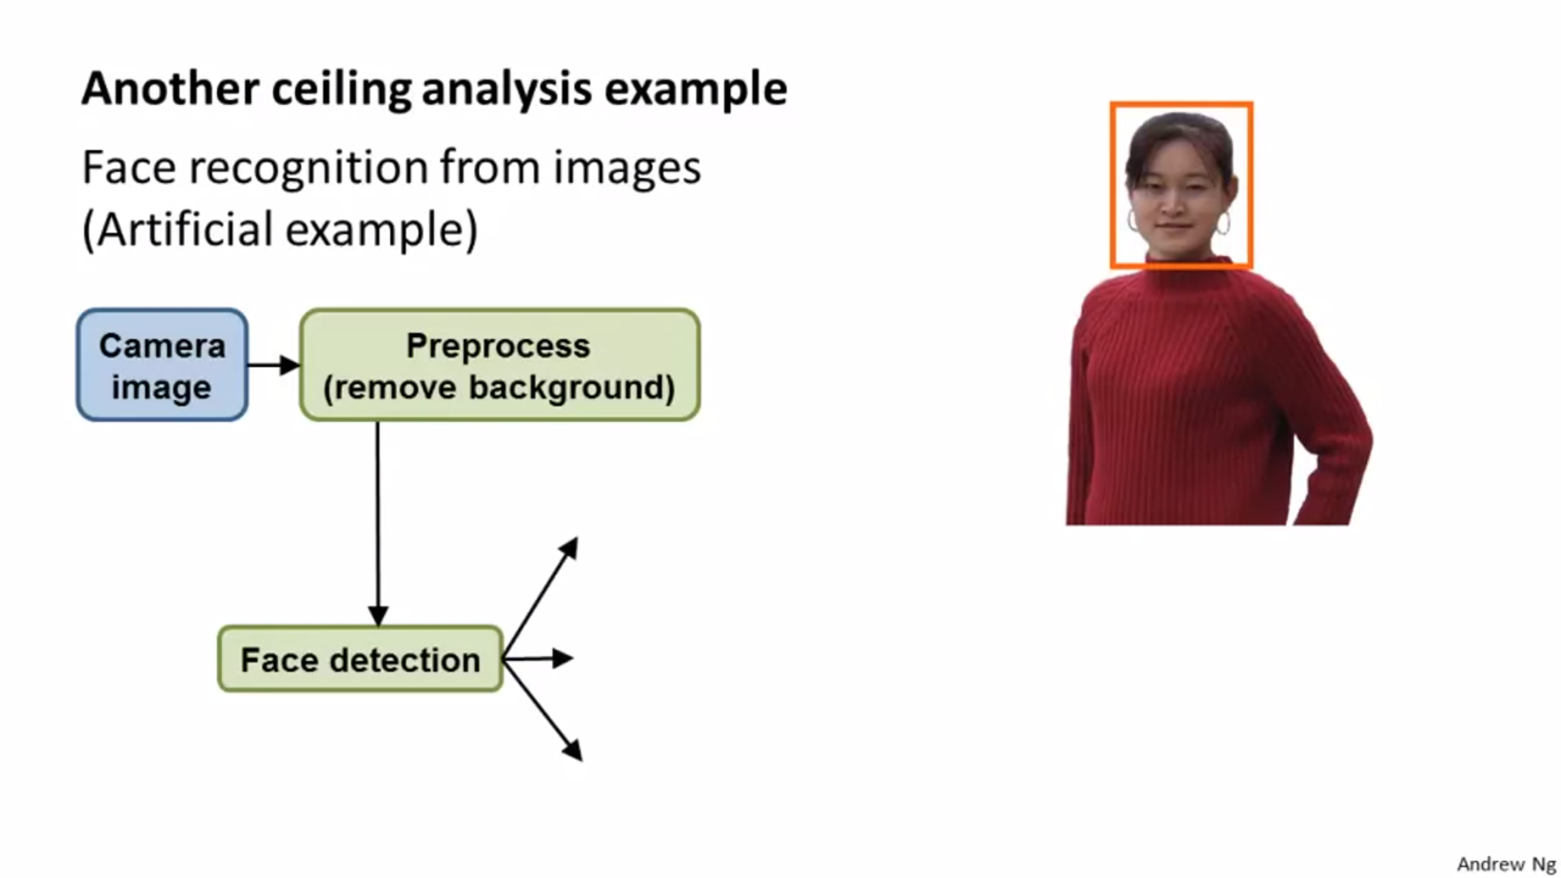

Slide 27
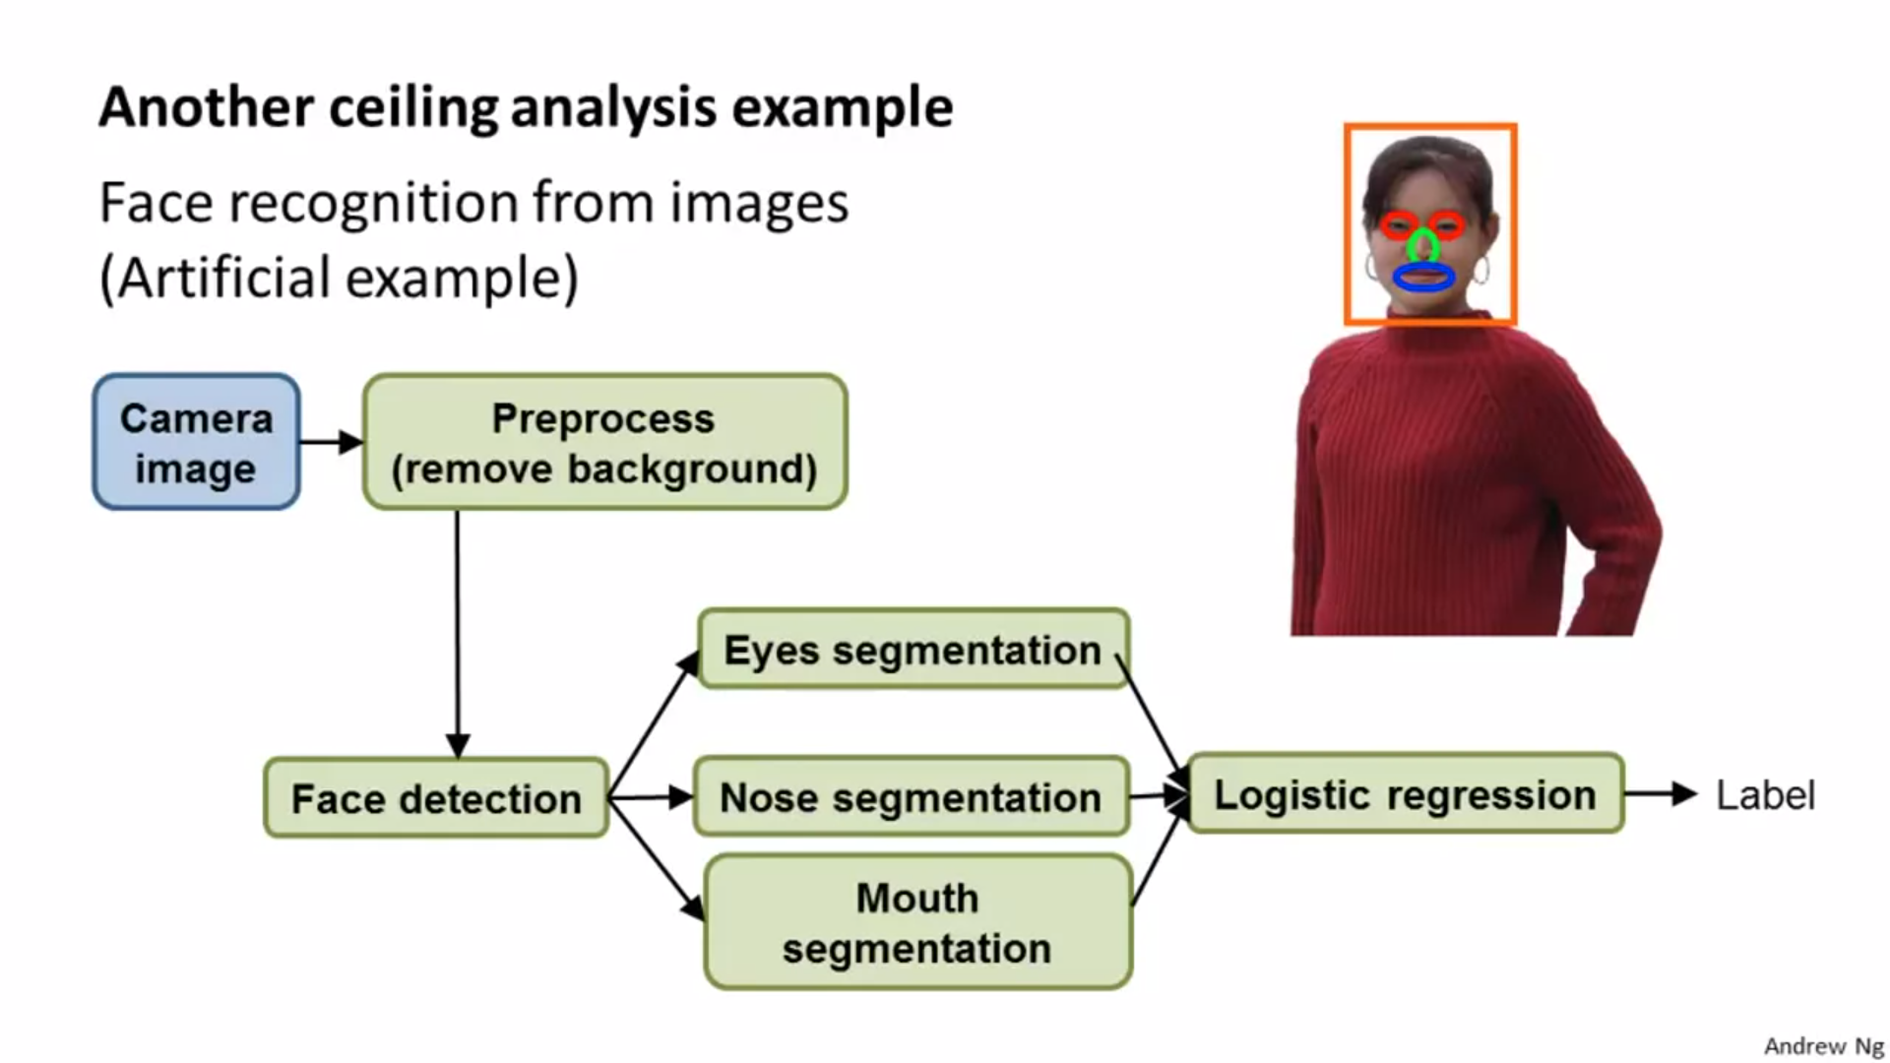

Slide 28
